Slide 1


The Central Force Problem
Dr. Yogesh Sonvane
Assistant Professor
Department of Applied Physics
Sardar Vallabhbhai National Institute of Technology, Surat

Slide 2
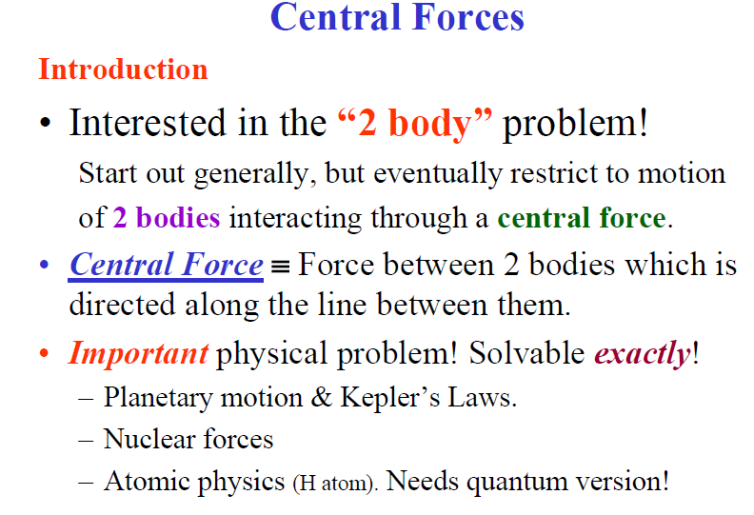

Slide 3
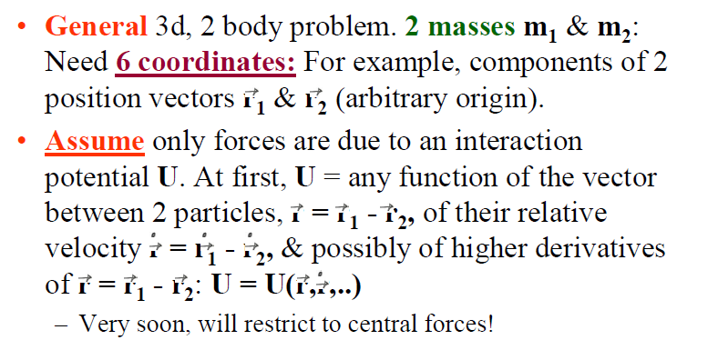
Reduction to Equivalent 1-Body Problem

Slide 4
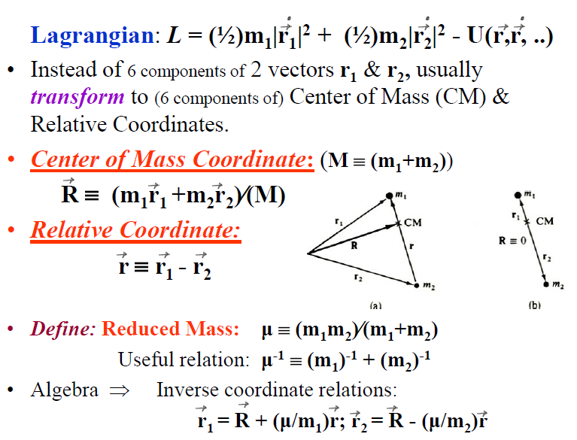

Slide 5
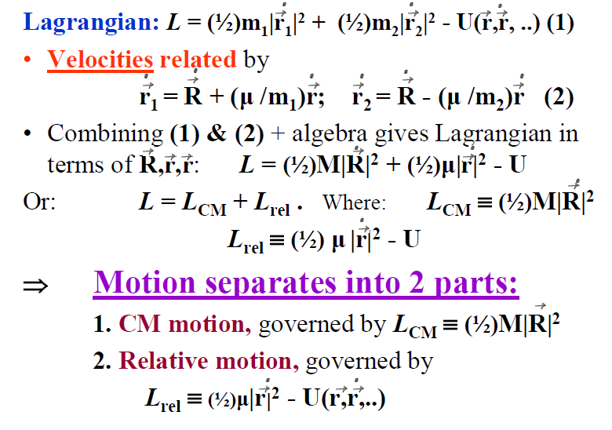

Slide 6
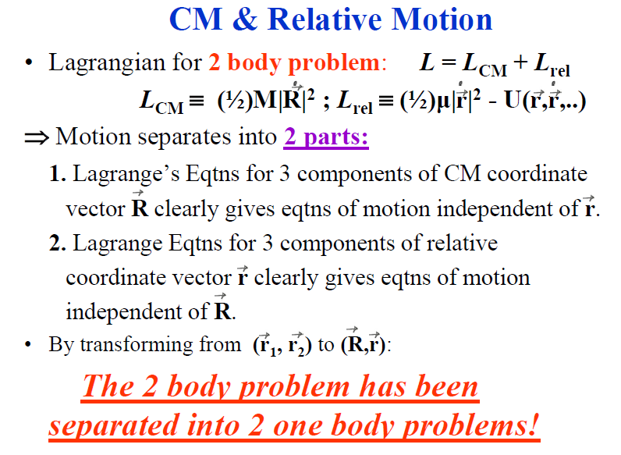

Slide 7
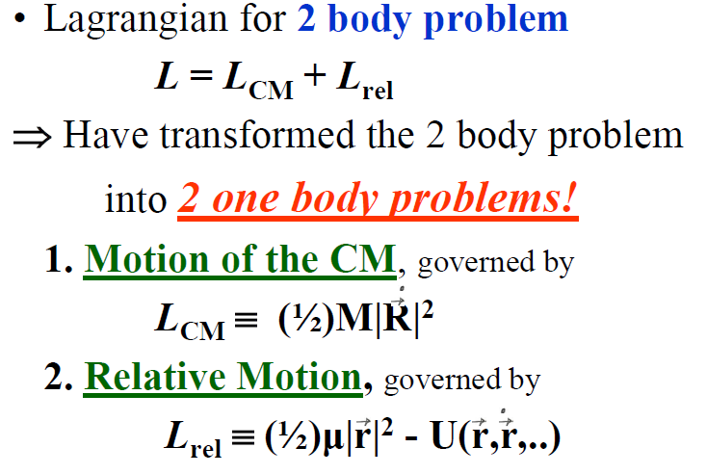

Slide 8
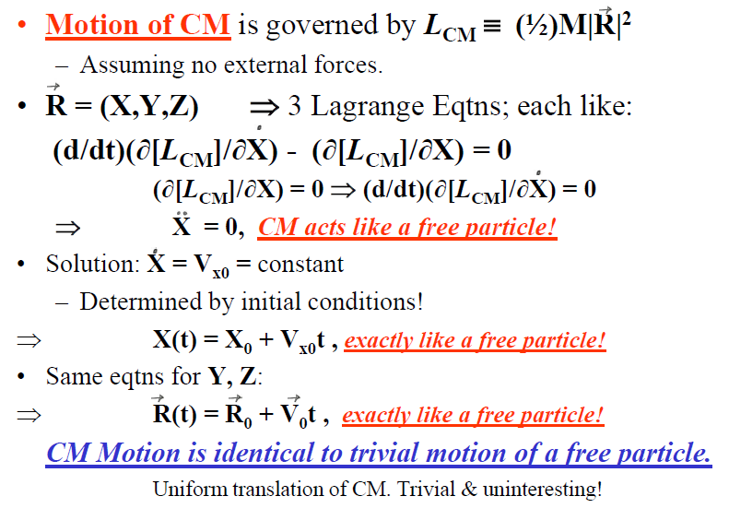

Slide 9
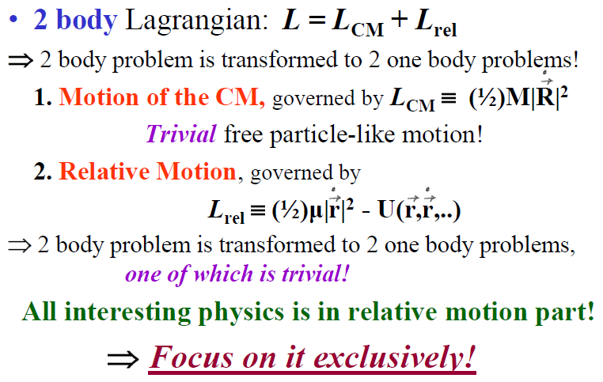

Slide 10
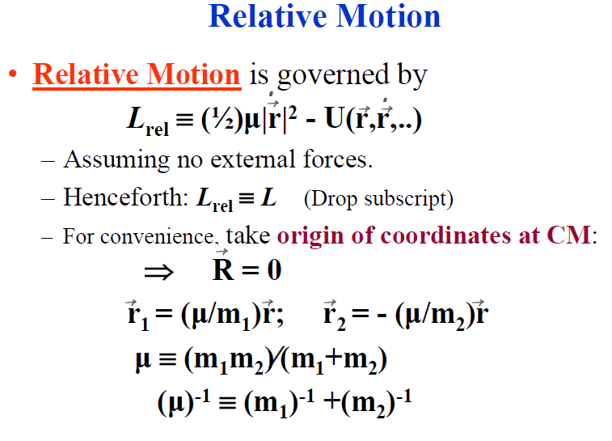

Slide 11
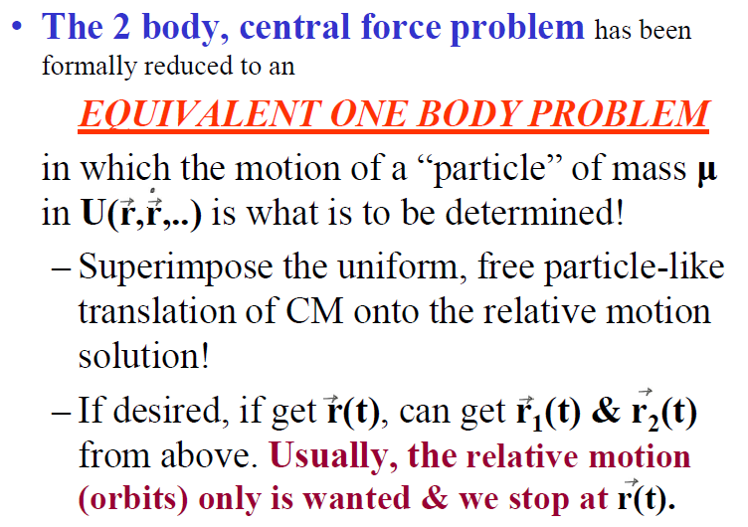

Slide 12
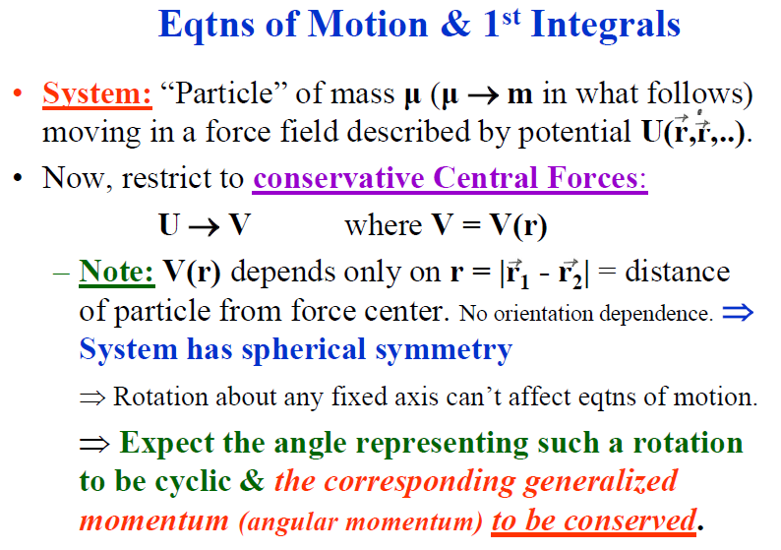

Slide 13
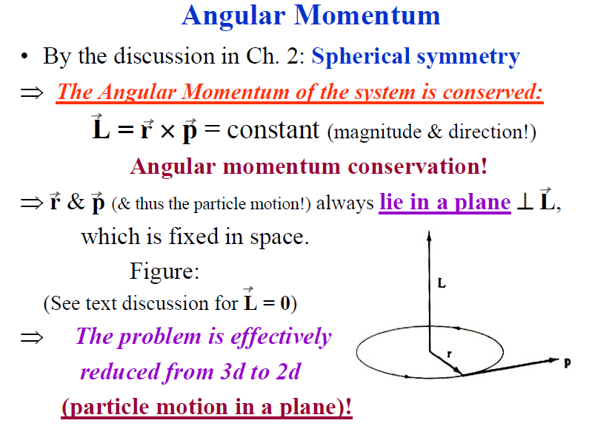

Slide 14
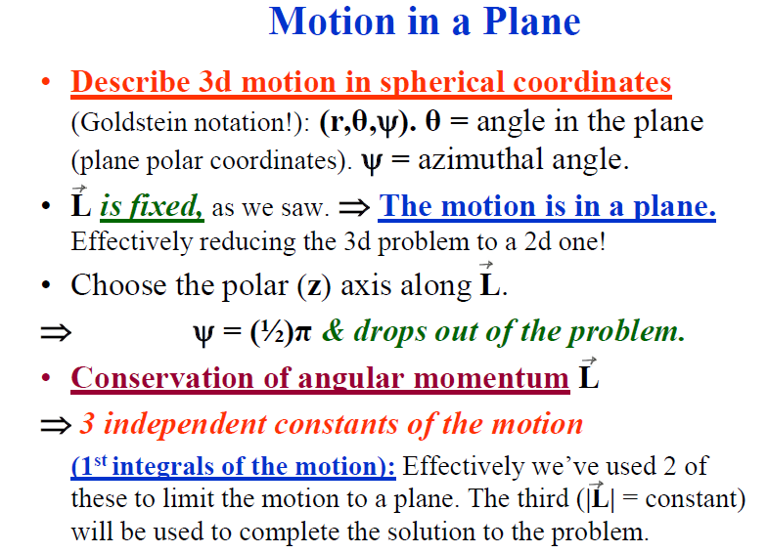

Slide 15
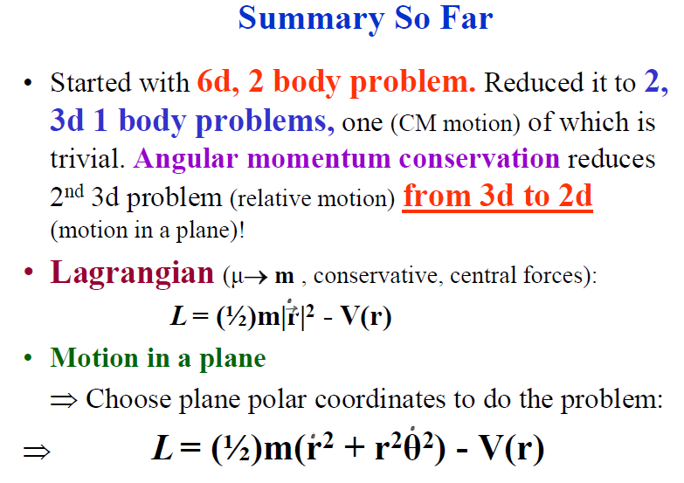

Slide 16
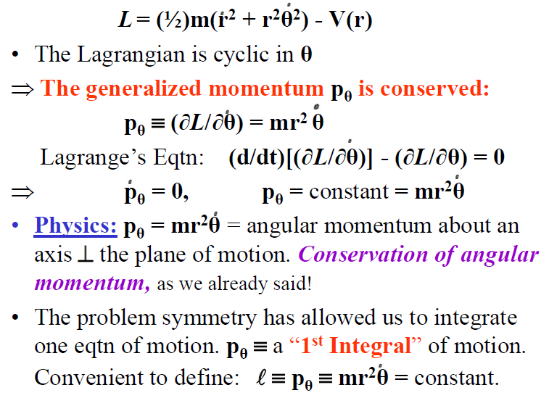

Slide 17
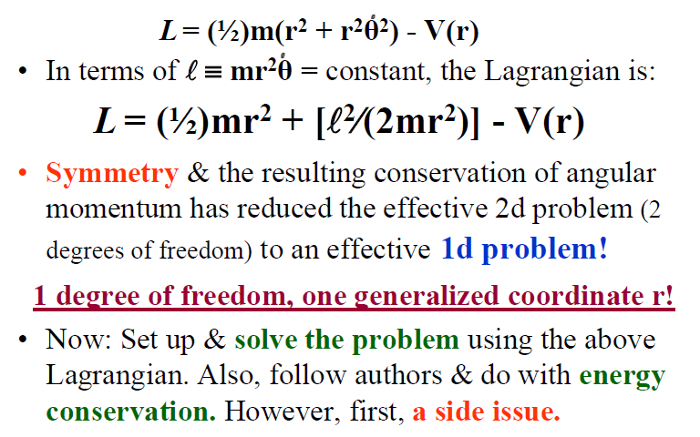

Slide 18
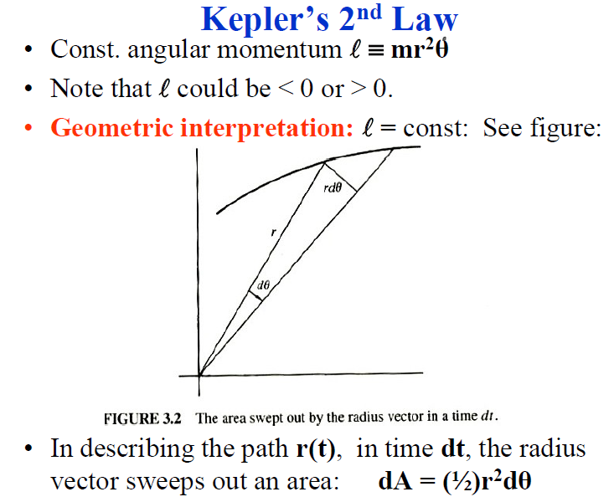

Slide 19
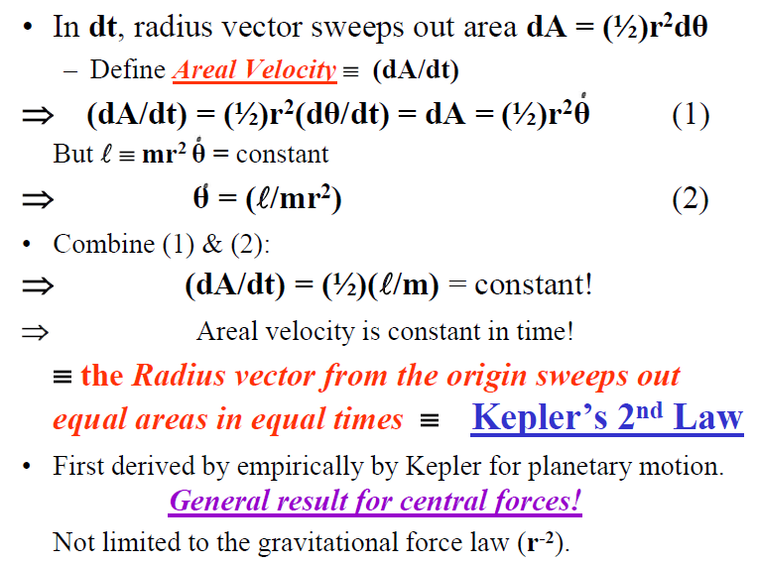

Slide 20
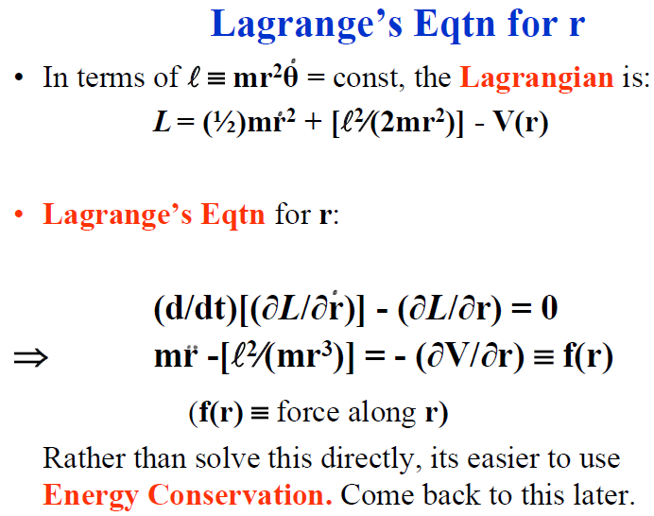

Slide 21
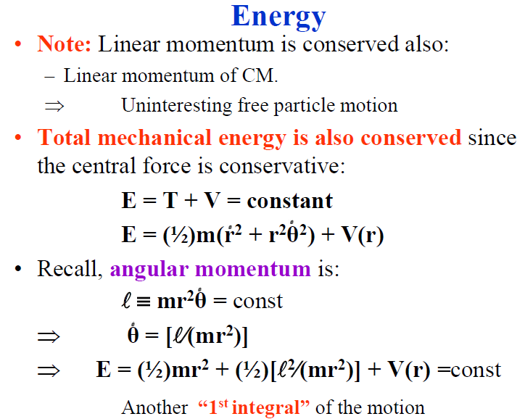

Slide 22
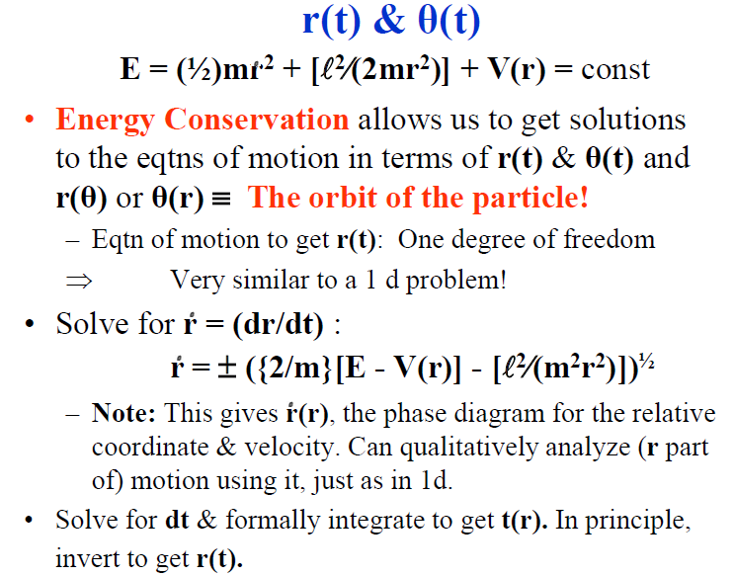

Slide 23
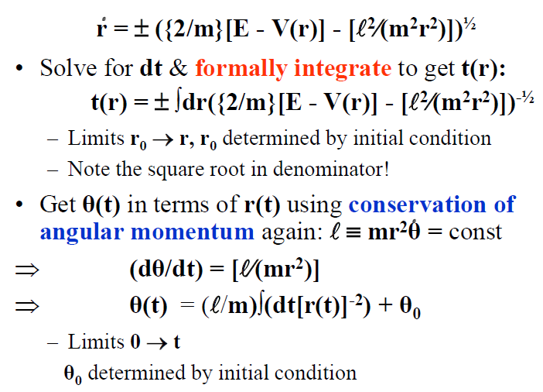

Slide 24
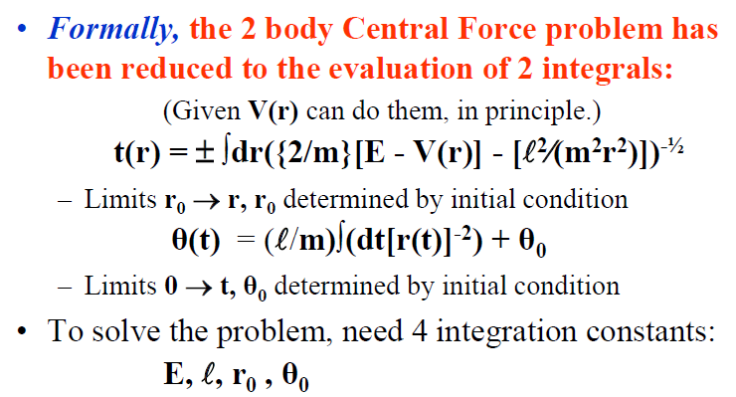

Slide 25
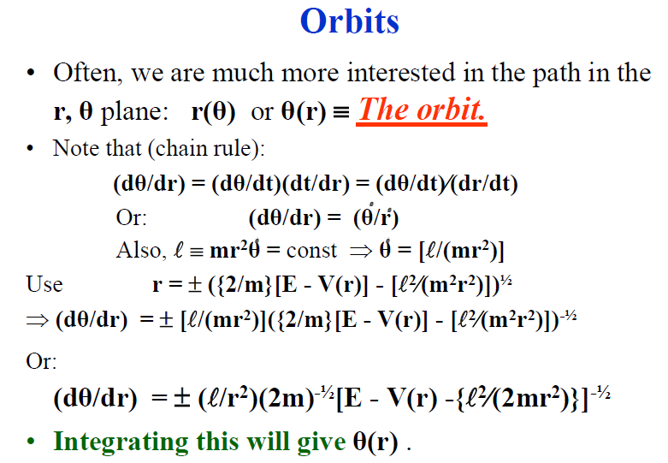

Slide 26
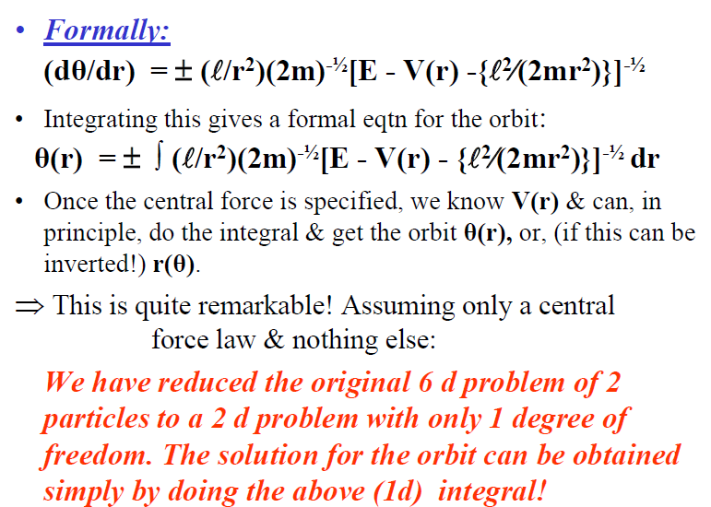

Slide 27
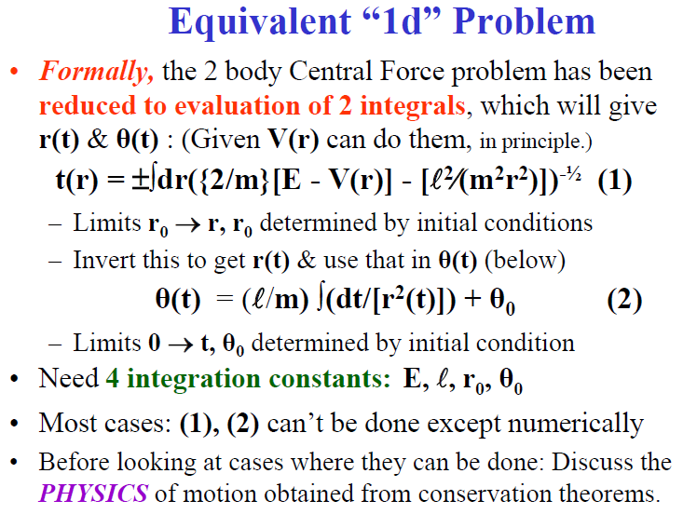

Slide 28
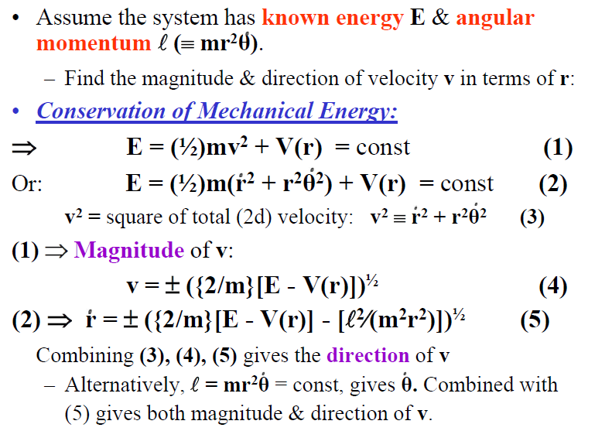

Slide 29
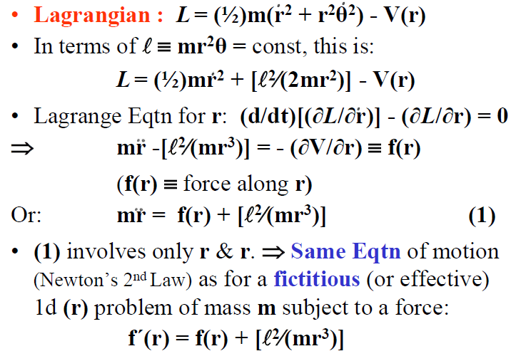

Slide 30
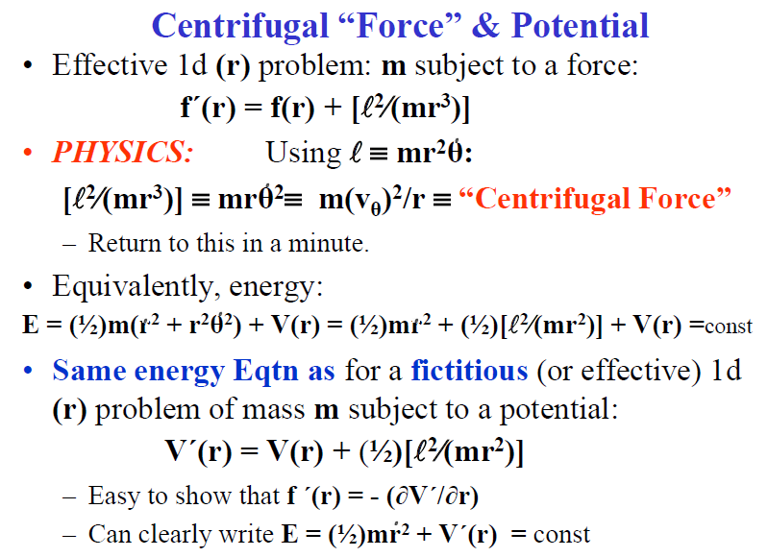

Slide 31
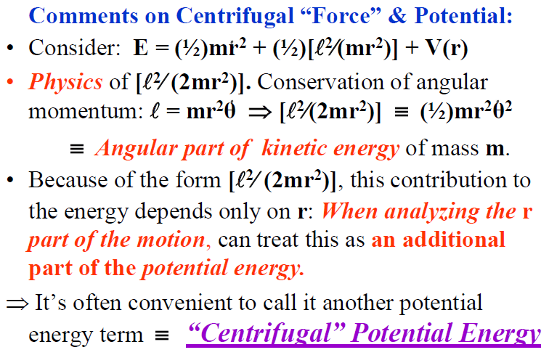

Slide 32
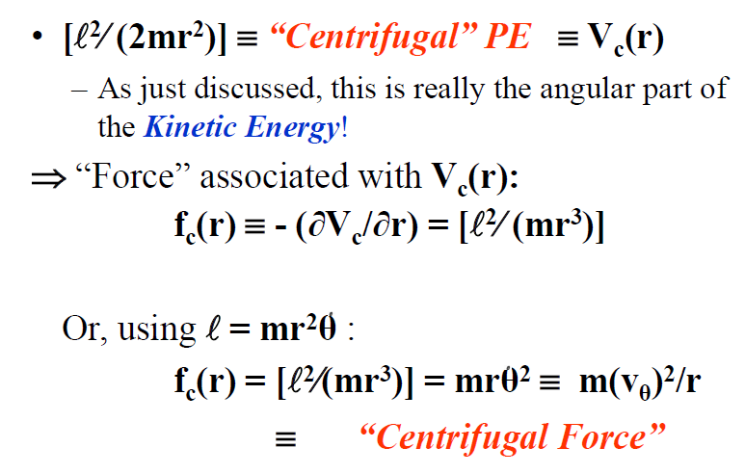

Slide 33
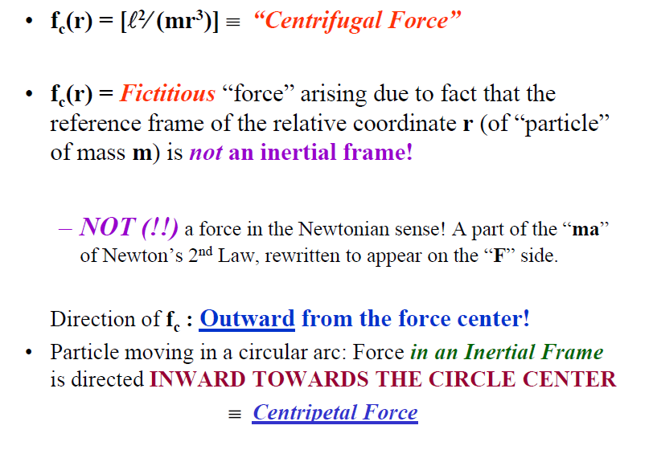

Slide 34
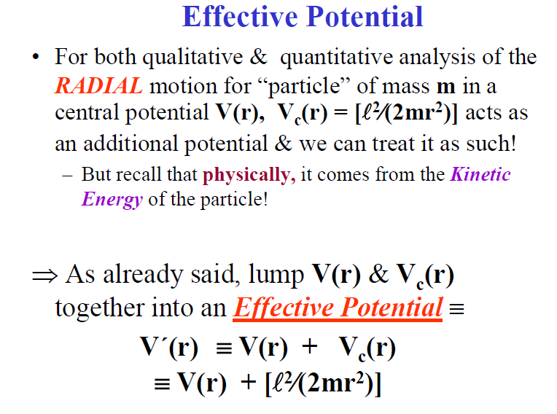

Slide 35
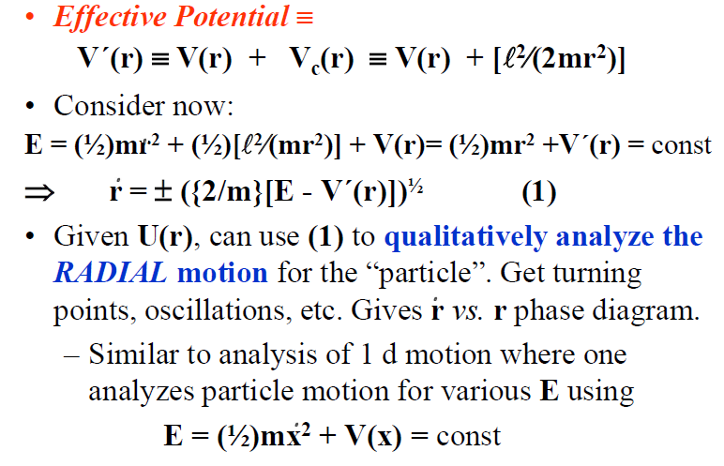

Slide 36
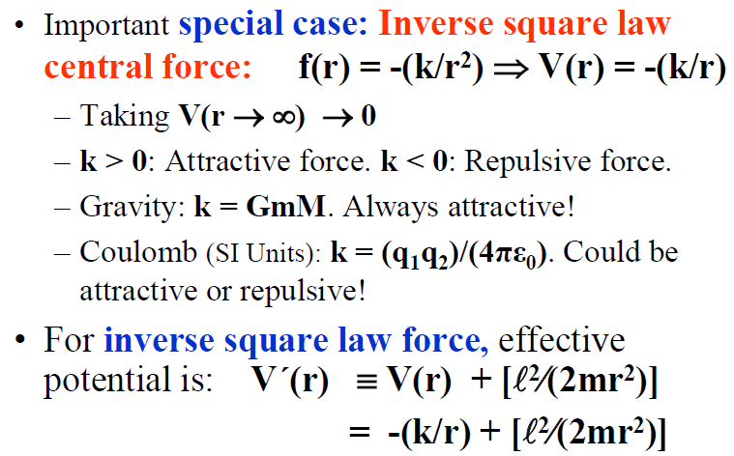

Slide 37
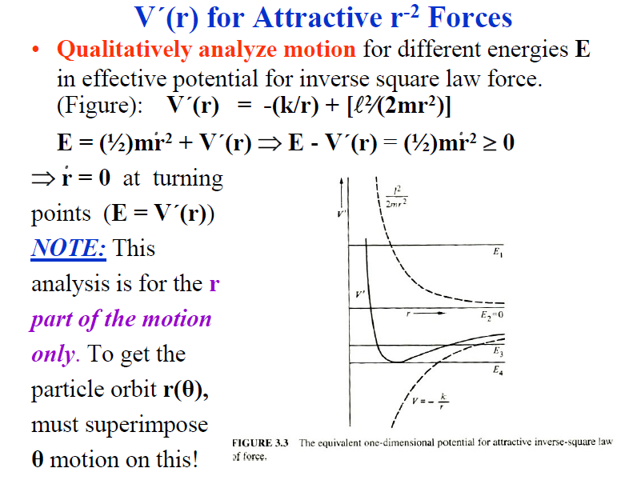

Slide 38
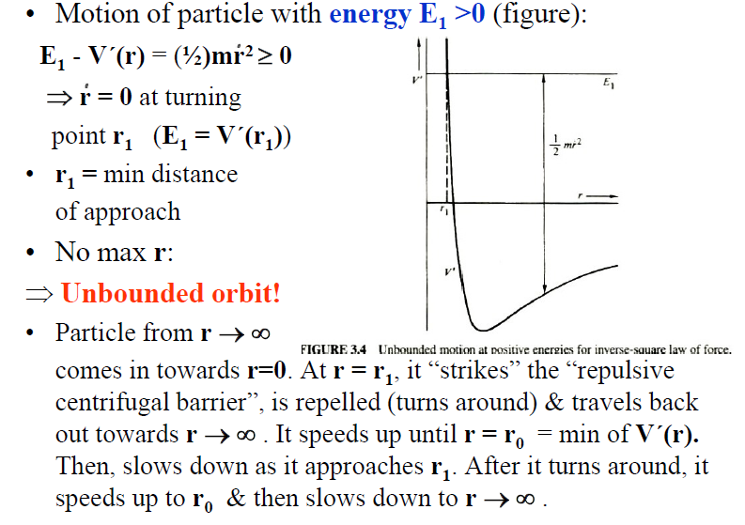

Slide 39
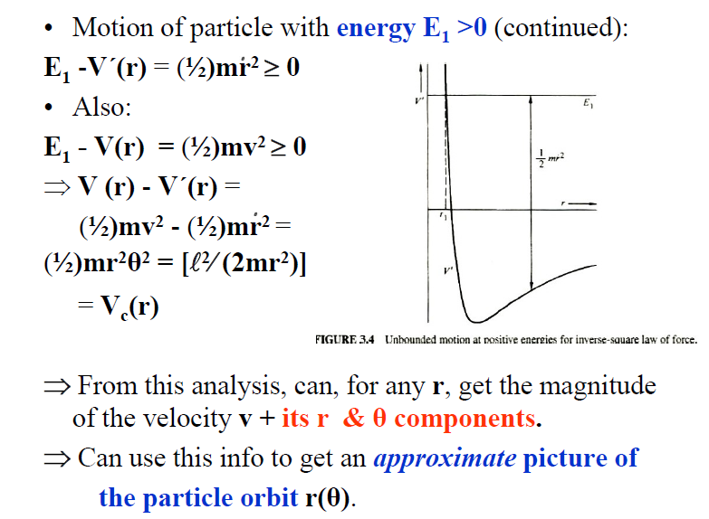

Slide 40
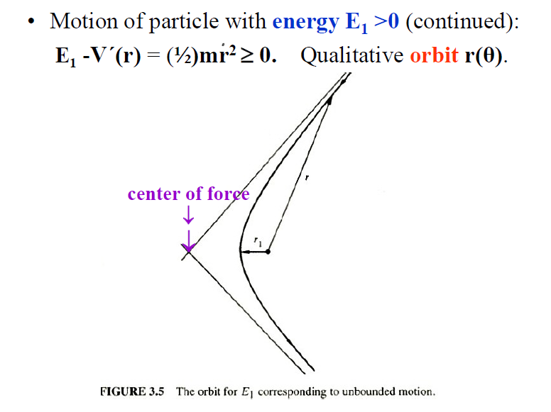

Slide 41
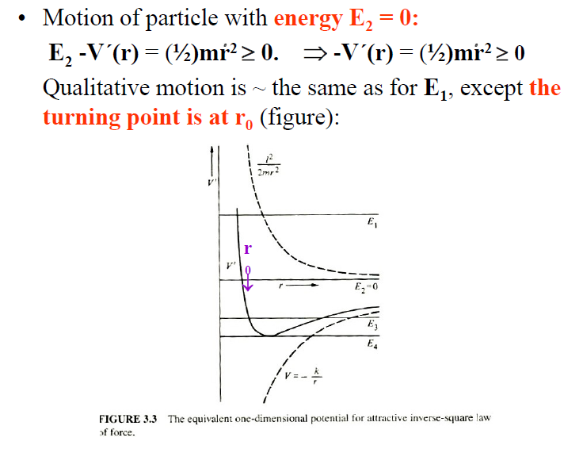

Slide 42
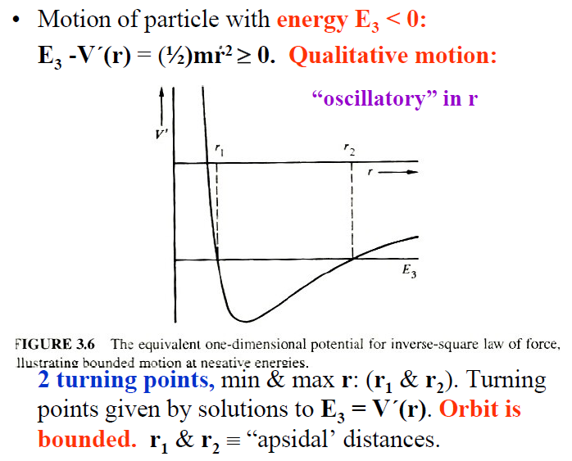

Slide 43
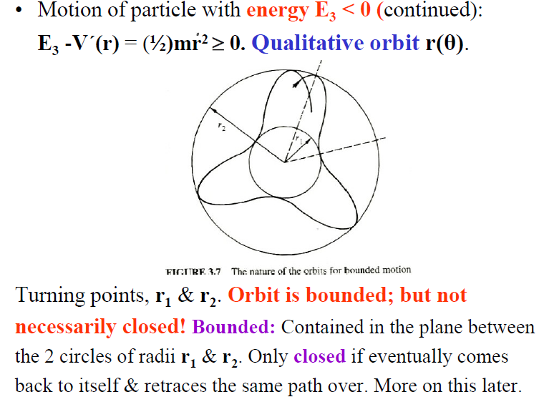

Slide 44
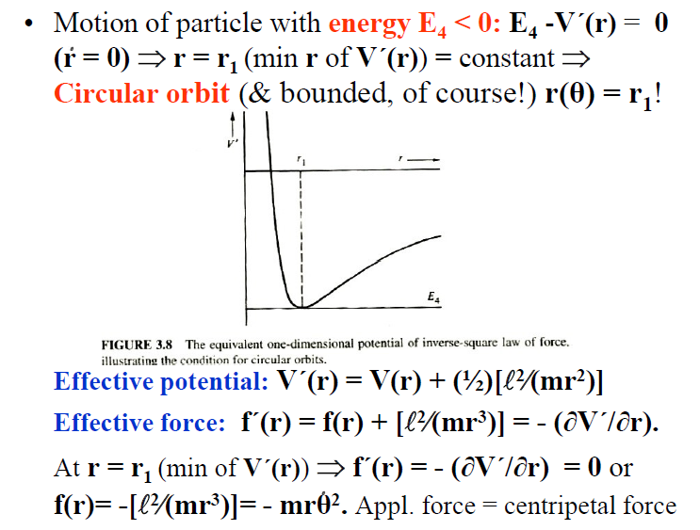

Slide 45
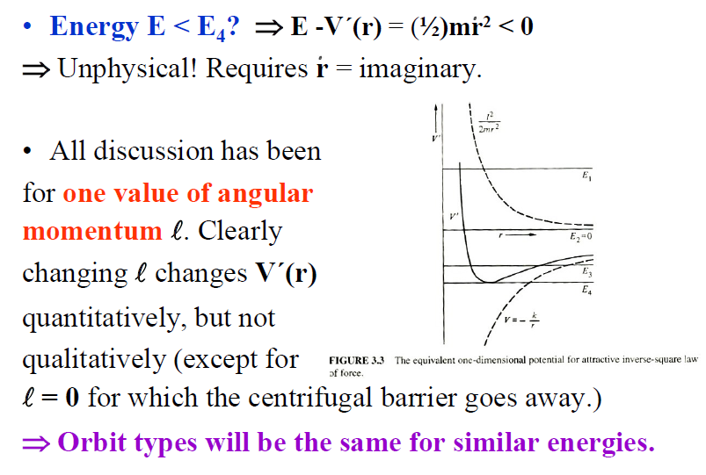

Slide 46
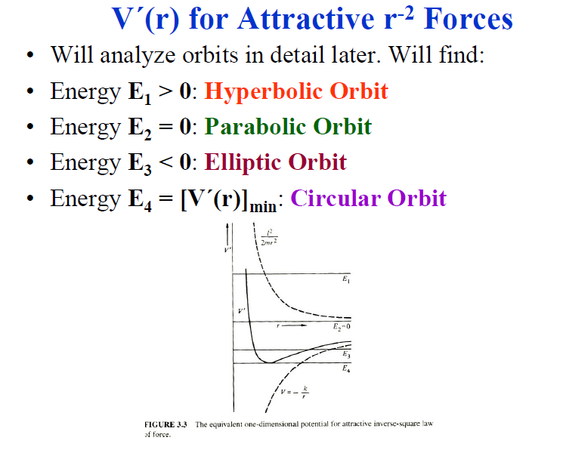

Slide 47
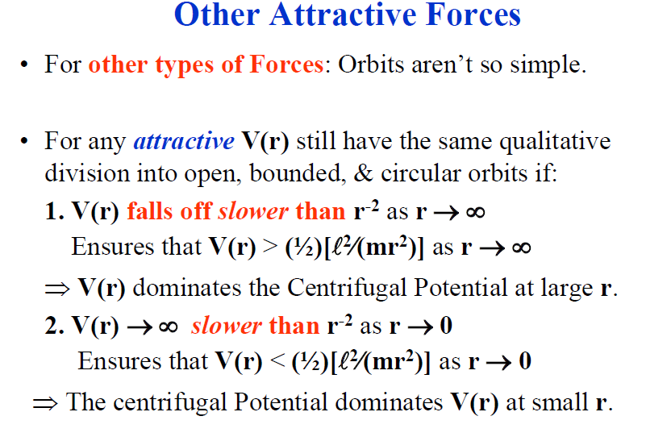

Slide 48
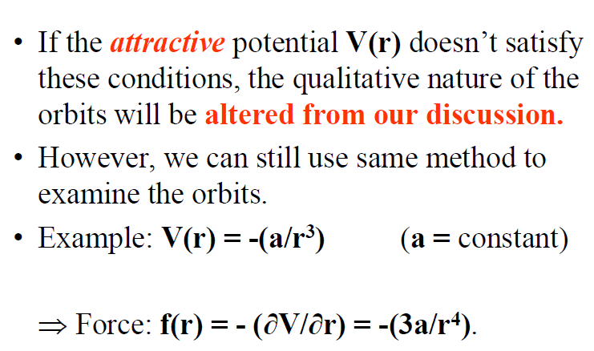

Slide 49
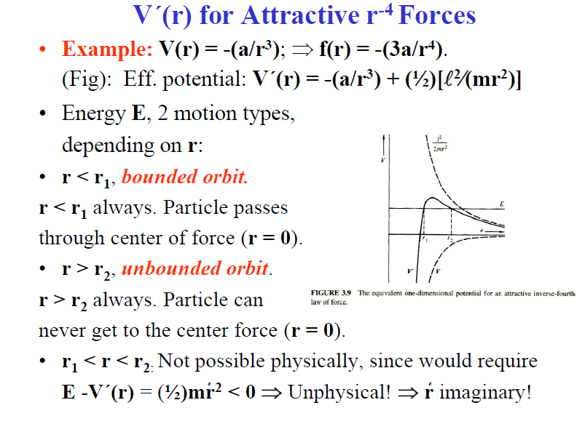

Slide 50
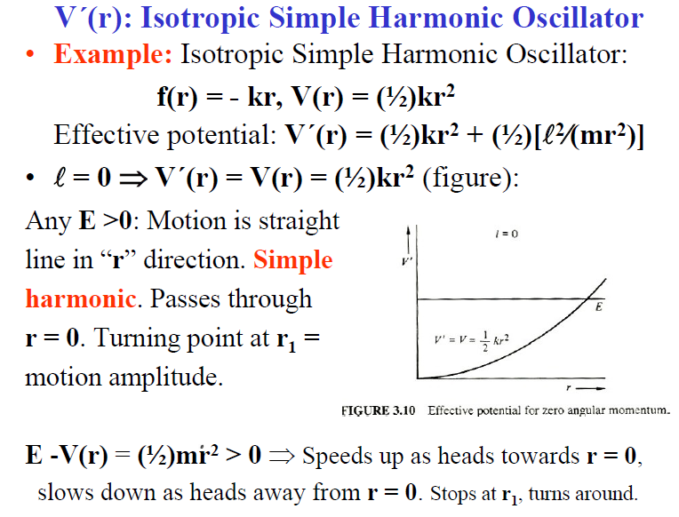

Slide 51
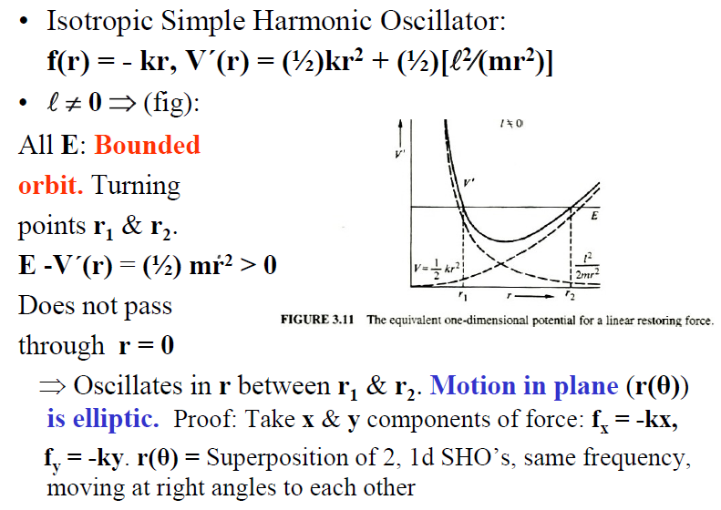

Slide 52
Kepler Problem: r⁻² Force Law
Inverse square law force:
F(r) = -(k/r²); V(r) = -(k/r)
The most important special case of Central Force motion!
Special case: Motion of planets (& other objects) about Sun. (Also, of course, motion of Moon & artificial satellites about Earth!)
Force = Newton’s Universal Law of Gravitation
⇒ k = GmM; m = planet mass, M = Sun mass
(or m = Moon mass, M = Earth mass)

Slide 53

Relative coordinate problem was solved using reduced mass μ: μ⁻¹ ≡ m⁻¹ + M⁻¹ = (m⁻¹)[1+ mM⁻¹]

Slide 54
μ⁻¹ ≡ m⁻¹ + M⁻¹ = (m⁻¹)[1+ mM⁻¹]
From Table: For all planets
m < < M ⇒ μ⁻¹ ≅ m⁻¹ or μ ≅ m
Similarly, ≈ true for Moon and Earth
Definitely true for artificial satellites & Earth!
Corrections: μ = (m)[1+ mM⁻¹]⁻¹
μ ≅ m[1 - mM⁻¹ + mM⁻² - ... ]
⇒ In what follows, μ is replaced by m (as it has been for most of the discussion so far)
Note also (useful for numerical calculations): ⇒ (k/μ) ≅ (k/m) ≅ GM

Slide 55

CONIC SECTIONS
Conic Section: Any figure that can be formed by slicing a double cone with a plane

Slide 56

OTHER VIEW OF CONIC SECTIONS

Slide 57

THE CIRCLE

Slide 58

CONIC SECTION – THE CIRCLE

Slide 59
Equation for a Circle
Standard Form: x² + y² = r²
You can determine the equation for a circle by using the distance formula then applying the standard form equation.
Or you can use the standard form.
Most of the time we will assume the center is (0,0). If it is otherwise, it will be stated.
It might look like: (x-h)² + (y – k)² = r²

Slide 60
ELLIPSES
Ellipse – A set of points in A plane such that the sum of the distance from two foci to any point on the ellipse is constant
focus (foci - plural) – one of two fixed points within in an ellipse such that the sum of the distances from the points to any other point on the ellipse is constant

Slide 61
Vocabulary for Ellipses
Vertices – for an ellipse, the y and x intercepts are the vertices
Major axis – for an ellipse, the longer axis of symmetry, the axis that contains the foci
Minor axis – for an ellipse, the shorter axis of symmetry
Center – for an ellipse, the intersection of the major and minor arcs

Slide 62

Equation for an Ellipse

Slide 63

Parts of an Ellipse

Slide 64

EXAMPLES
Perihelion – point closest to the sun in such an orbit
Aphelion – point farthest from the sun in such an orbit

Slide 65
HYPERBOLAS
Hypoberla – a set of points such that the difference of the distances from two fixed points to any point on the hyperbola is constant
Vertices – x or y intercepts of a hyperbola
Asymptote – a straight line that a curve approaches but never reaches

Slide 66

WHAT DOES IT LOOK LIKE?AND WHAT IT ITS FORMULA?

Slide 67

ASYMPTOTES (IN RED)

Slide 68

ASYMPTOTES

Slide 69
PARABOLAS
Parabolas – a set of points in a plane that are equidistant from a focus and a fixed line – the directrix
Directrix – the fixed straight line that together with the point known as the focus serves to define a parabola.

Slide 70

WHAT DOES IT LOOK LIKE?

Slide 71
ECCENTRICITY
Eccentricity – a ratio of the distance from the focus and the distance from the directrix.
Each shape has its own eccentricy: circle, parabolas, hyperbolas, and ellipses.
Circle: e = 0
Ellipse: e = 0 < e < 1
Parabola: e = 1
Hyperbola: e > 1

Slide 72
Definition: Eccentricity of an Ellipse
The eccentricity of an ellipse is
where a is the semimajor axis, b is the semiminor axis, and c is
the distance from the center of the ellipse to either focus.
What is the range of possible “e” values for an ellipse?
What happens when “e” is zero?
→ A CIRCLE!!!

Slide 73
Practice Problems
The Earth’s orbit has a semimajor axis
and an eccentricity of .
Calculate and interpret b and c.
Semiminor Axis
The semiminor axis is only 0.014% shorter
than the semimajor axis…

Slide 74
Practice Problems
The Earth’s orbit has a semimajor axis
and an eccentricity of .
Calculate and interpret b and c.
Aphelion of Earth:
Perihelion of Earth:
The Earth’s orbit is nearly a perfect circle, but
the eccentricity as a percentage is 1.67%; this
measures how far off-center the Sun is…

Slide 75
Planetary Motion
General result for Orbit θ(r) was:
θ(r) = ± ∫(/r²)(2m)^{-½}[E - V(r) - {²⁄(2mr²)}]^{-½} dr + θ´
θ´ = integration constant
Put V(r) = -(k/r) into this:
θ(r) = ± ∫(/r²)(2m)^{-½}[E + (k/r)- {²⁄(2mr²)}]^{-½} dr + θ´
Integrate by first changing variables: Let u ≡ (1/r):
θ(u) = (2m)^{-½}∫du [E + k u - {²⁄(2m)}u²]^{-½} + θ´
Tabulated. Result is: (r = 1/u)
θ(r) = cos⁻¹[G(r)] + θ´
G(r) ≡ [(α/r) -1]/e ; α ≡ [²⁄(mk)]
e ≡ [ 1 + {2E²⁄(mk²)}]^{½}

Slide 76
Orbit for inverse square law force:
cos(θ - θ´) = [(α/r) -1]/e (1)
α ≡ [²⁄(mk)]; e ≡ [ 1 + {2E²⁄(mk²)}]^{½}
Rewrite (1) as:
(α/r) = 1 + e cos(θ - θ´) (2)
(2) ≡ CONIC SECTION (analytic geometry!)
Orbit properties:
e ≡ Eccentricity
2α ≡ Latus Rectum

Slide 77
Conic Sections
⇒ A very important result!
All orbits for inverse r-squared forces (attractive or repulsive) are conic sections
(α/r) = 1 + e cos(θ - θ´)
with
Eccentricity ≡ e = [ 1 + {2E²⁄(mk²)}]^{½}
and
Latus Rectum ≡ 2α = [2²⁄(mk)]

Slide 78
Conic Sections
Conic sections: Curves formed by the intersection of a plane and a cone.
A conic section: A curve formed by the loci of points (in a plane) where the ratio of the distance from a fixed point (the focus) to a fixed line (the directorix) is a constant.
Conic Section
(α/r) = 1 + e cos(θ - θ´)
The specific type of curve depends on eccentricity e. For objects in orbit, this, in turn, depends on the energy E and the angular momentum .

Slide 79

Conic Section
(α/r) = 1 + e cos(θ - θ´)
Type of curve depends
on eccentricity e.
In Figure, ε ≡ e

Slide 80
Conic Section Orbits
In the following discussion, we need 2 properties of the effective (1d, r-dependent) potential, which (as we’ve seen) governs the orbit behavior for a fixed energy E & angular momentum . For V(r) = -(k/r) this is:
V´(r) = -(k/r) + [²⁄ {2m(r)²}]
1. It is easily shown that the r = r₀ where V´(r) has a minimum is: r₀ = [²⁄ (2mk)]. (We’ve seen in our general discussion that this is the radius of a circular orbit.)
2. Its also easily shown that the value of V´at r₀ is: V´(r₀) = -(mk²)/(2²) ≡ (V´)_{min} ≡ E_{circular}

Slide 81
We’ve shown that all orbits for inverse r-squared forces (attractive or repulsive) are conic sections
(α/r) = 1 + e cos(θ - θ´)
As we just saw, the shape of curve (orbit) depends on the eccentricity e ≡ [ 1 + {2E²⁄(mk²)}]^{½}
Clearly this depends on energy E, & angular momentum !
Note: (V´)_{min} ≡ -(mk²)/(2²)
e > 1 ⇒ E > 0 ⇒ Hyperbola
e = 1 ⇒ E = 0 ⇒ Parabola
0 < e < 1 ⇒ (V´)_{min} < E < 0 ⇒ Ellipse
e = 0 ⇒ E = (V´)_{min} ⇒ Circle
e = imaginary ⇒ E < (V´)_{min} ⇒ Not Allowed!

Slide 82
Terminology for conic section orbits:
Integration const ⇒ r = r_{min} when θ = θ´
r_{min} ≡ Pericenter ; r_{max} ≡ Apocenter
Any radial turning point ≡ Apside
Orbit about sun: r_{min} ≡ Perihelion
r_{max} ≡ Aphelion
Orbit about earth: r_{min} ≡ Perigee
r_{max} ≡ Apogee

Slide 83
Conic Section: (α/r) = 1 + e cos(θ - θ´)
e ≡ [ 1 + {2E²⁄(mk²)}]^{½} α ≡ [²⁄(mk)]
e > 1 ⇒ E > 0 ⇒ Hyperbola
Occurs for the repulsive Coulomb force: See scattering discussion,
0 < e < 1 ⇒ V_{min} < E < 0 ⇒ Ellipse
(V_{min} ≡ -(mk²)/(2²)) Occurs for the attractive Coulomb force & the Gravitational force:
The Orbits of all of the planets (& several other solar system objects) are ellipses with the Sun at one focus. (Again, see table).
Most planets, e <<1 (see table) ⇒ Their orbit is almost circular!

Slide 84

Planetary Orbits
Planetary orbits in terms of ellipse geometry.
In the figure, ε ≡ e
Compute major & minor
axes (2a & 2b) as in text.
Get (recall k = GmM):
a ≡ (α)/[1 - e²] = (k)/(2|E|)
(depends only on energy E)
b ≡ (α)/[1 - e²]^{½} = ()/(2m|E|)^{½} ≡ a[1 - e²]^{½} ≡ (αa)^{½}
(Depends on both energy E & angular momentum )
Apsidal distances r_{min} & r_{max} (or r₁ & r₂):
r_{min} = a(1- e) = (α)/(1 + e), r_{max} = a(1+ e) = (α)/(1 - e)
⇒ Orbit eqtn is: r = a(1- e²)/[1 + e cos(θ - θ´)]

Slide 85
Planetary orbits = ellipses, sun at one focus: Fig:
For a general central force,
we had Kepler’s 2nd Law:
(Constant areal velocity!):
(dA/dt) = ()/(2m) = const
Use to compute orbit period:
⇒ dt = (2m)/() dA
Period = time to sweep out ellipse area:
τ = ∫dt = [(2m)/()] ∫dA = [(2m)/()]A

Slide 86
Period of elliptical orbit:
τ = [(2m)/()] A (A = ellipse area) (1)
Analytic geometry: Area of ellipse:
A ≡ πab (2)
In terms of k, E & , we just had:
a = (k)/(2|E|); b = ()/(2mE)^{½} (3)
(1), (2), (3) ⇒ τ = πk(m/2)^{½}|E|^{-(3/2)}
Alternatively: b = (αa)^{½} ; α ≡ [²⁄(mk)]
⇒ τ² = [(4π²m)/(k)] a³
The square of the period is proportional to cube of semimajor axis of the elliptic orbit
≡ Kepler’s Third Law

Slide 87
Kepler’s Third Law
⇒ τ² = [(4π²m)/(k)] a³
The square of period is proportional to the cube of the semimajor axis of the elliptic orbit
Note: Actually, m → μ. The reduced mass μ actually enters! As derived empirically by Kepler: Kepler’s 3rd Law states that this is true with the same proportionality constant for all planets. This ignores the difference between the reduced mass μ & the mass m of the planet: μ = (m)[1 + mM⁻¹]⁻¹
μ ≅ m[1 - (m/M) + (m/M)² - ... ]
Note: k = GmM ; μ ≅ m (m << M)
⇒ (μ/k) ≅ 1/(GM)
⇒ τ² = [(4π²)/(GM)]a³ (m << M)
So Kepler was only approximately correct!

Slide 88
Kepler’s Laws
Kepler’s First Law:
The planets move in elliptic orbits with the Sun at one focus.
Kepler proved empirically. Newton proved this from Universal Law of Gravitation & calculus.
Kepler’s Second Law:
The area per unit time swept out by a radius vector from sun to a planet is constant. (Constant areal velocity).
(dA/dt) = ()/(2m) = constant
Kepler proved empirically. We’ve proven in general for any central force.
Kepler’s Third Law: τ² = [(4π²m)/(k)] a³
The square of a planet’s period is proportional to cube of semimajor axis of the planet’s elliptic orbit.

Slide 89
Example
Halley’s Comet, which passed around the sun early in 1986, moves in a highly elliptical orbit: Eccentricity e = 0.967; period τ = 76 years. Calculate its minimum and maximum distances from the sun.
Use the formulas just derived & find:
r_{min} = 8.8 × 10¹⁰ m
(Inside Venus’s orbit & almost to Mercury’s orbit)
r_{max} = 5.27 × 10¹² m
(Outside Neptune’s orbit & near to Pluto’s orbit)

Slide 90

Elliptical orbits: Same semimajor axis a = (k)/(2|E|)
⇒ Same energy E & mass m, different eccentricities
e = [1+{2E²⁄(mk²)}]^{½} (& semiminor axes)
b = ()/(2m|E|)^{½} ⇒ Different angular momenta 

Slide 91

Orbit properties: r₁, r₂ ≡ apsidal distances, p_{r}, p_{θ} ≡ angular momenta, θ₁, θ₂ ≡ angular velocities at the apsidal distances, with respect to circular orbit, radius a. In Table, ε ≡ e
Velocity along particle path ≡ v = v_{r}r + v_{θ}θ
v_{r} ≡ (p_{r}/m) = r, v_{θ} ≡ rθ = [p_{θ}/(mr)]

Slide 92



Orbit phase space properties:
p_{θ} vs. θ
p_{r} vs. r
v_{θ} vs. θ

Slide 108


Solution on Board!

Slide 109


Solution on Board!

Slide 118
Central Force Field Scattering
Application of Central Forces outside of astronomy: Scattering of particles.
Atomic scale scattering: Need QM of course!
Description of scattering processes:
Independent of CM or QM.
1 body formulation = Scattering of particles by a
Center of Force.
Original 2 body problem = Scattering of “particle” with the reduced mass μ from a center of force
Here, we go right away to the 1 body formulation, while bearing in mind that it really came from the 2 body problem.

Slide 119
Consider a uniform beam of particles (of any kind) of equal mass and energy incident on a center of force (Central force f(r)).
Assume that f(r) falls off to zero at large r.
Incident beam is characterized by an intensity (flux density) I ≡ # particles crossing a unit area (⊥ beam) per unit time (= # particles per m³ per s)
As a particle approaches the center of force, it is either attracted or repelled & thus it’s orbit will be changed (deviate from the initial straight line path).
⇒ Direction of final motion is not the same as incident motion. ⇒ ≡ Particle is Scattered

Slide 120

For repulsive scattering (what we mainly look at here) the situation is as shown in the figure:
Define: Cross Section for Scattering in a given direction (into a given solid angle dΩ):
σ(Ω)dΩ ≡ (N_{s}/I). With I = incident intensity
N_{s} = # particles/time scattered into solid angle dΩ

Slide 121
Scattering Cross Section:
σ(Ω)dΩ ≡ (N_{s}/I)
I = incident intensity
N_{s} = # particles/time
scattered into angle dΩ
In general, the solid angle Ω depends on the spherical angles Θ, Φ. However, for central forces, there must be symmetry about the axis of the incident beam
⇒ σ(Ω) (≡ σ(Θ)) is independent of azimuthal angle Φ
⇒ dΩ ≡ 2π sinΘdΘ , σ(Ω)dΩ ≡ 2π sinΘdΘ,
Θ ≡ Angle between incident & scattered beams, as in the figure.
σ ≡ “cross section”. It has units of area
Also called the differential cross section.

Slide 122
As in all Central Force
problems, for a given
particle, the orbit, & thus
the amount of scattering,
is determined by the energy E & the angular momentum 
Define: Impact parameter, s, & express the angular momentum  in terms of E & s.
Impact parameter s ≡ the ⊥ distance between the center of force & the incident beam velocity (fig).
GOAL: Given the energy E, the impact parameter s, & the force f(r), what is the cross section σ(Θ)?

Slide 123
Beam, intensity I.
Particles, mass m,
incident speed
(at r → ∞) = v₀.
Energy conservation:
E = T + V = (½)mv² + V(r) = (½)m(v₀)² + V(r → ∞)
Assume V(r → ∞) = 0 ⇒ E = (½)m(v₀)²
⇒ v₀ = (2E/m)^{½}
Angular momentum:  ≡ mv₀s ≡ s(2mE)^{½}

Slide 124
Angular momentum  ≡ mv₀s ≡ s(2mE)^{½}
Incident speed v₀.
N_{s} ≡ # particles
scattered into solid
angle dΩ between
Θ & Θ + dΘ. Cross section definition
⇒ N_{s} ≡ Iσ(Θ)dΘ = 2πIσ(Θ)sinΘdΘ
N_{i} ≡ # incident particles with impact parameter between s & s + ds . N_{i} = 2πIsds
Conservation of particle number
⇒ N_{s} = N_{i} or: 2πIσ(Θ)sinΘ|dΘ| = 2πIs|ds|
2πI cancels out! (Use absolute values because N’s are always > 0, but ds & dΘ can have any sign.)

Slide 125
σ(Θ)sinΘ|dΘ| = s|ds| (1)
s = a function of energy
E & scattering angle Θ:
s = s(Θ,E)
(1) ⇒ σ(Θ) = (s/sinΘ) (|ds|/|dΘ|) (2)
To compute σ(Θ) we clearly need s = s(Θ,E)
Alternatively, could use Θ = Θ(s,E) & rewrite (2) as: σ(Θ) = (s/sinΘ)/[(|dΘ|/|ds|)] (2´)
Get Θ = Θ(s,E) from the orbit eqtn. For general central force (θ is the angle which describes the orbit r = r(θ); θ ≠ Θ)
θ(r) = ∫(/r²)(2m)^{-½}[E - V(r) - {²⁄(2mr²)}]^{-½}dr

Slide 126

Orbit eqtn. General central force:
θ(r) = ∫(/r²)(2m)^{-½}[E - V(r) - {²⁄(2mr²)}]^{-½}dr (3)
Consider purely repulsive scattering. See figure:
Closest approach distance ≡ r_{m}. Orbit must be symmetric about r_{m} ⇒ Sufficient to look at angle (see figure): Scattering angle Θ ≡ π - 2Ψ. Also, orbit angle
θ = π - Ψ in the special case r = r_{m}

Slide 127
⇒ After some manipulation can write (3) as:
Ψ = ∫(dr/r²)[(2mE)/(²) - (2mV(r))/(²) -1/(r²)]^{-½} (4)
Integrate from r_{m} to r → ∞
Angular momentum in
terms of impact parameter
s & energy E:  ≡ mv₀s ≡ s(2mE)^{½}. Put this into (4)
& get for scattering angle Θ (after manipulation):
Θ(s) = π - 2∫dr(s/r)[r²{1- V(r)/E} - s²]^{-½} (4´)
Changing integration variables to u = 1/r:
Θ(s) = π - 2∫sdu [1- V(r)/E - s²u²]^{-½} (4´´)
Integrate from u = 0 to u = u_{m} = 1/r_{m}

Slide 128
Summary: Scattering by a general central force:
Scattering angle Θ = Θ(s,E) (s = impact parameter, E = energy):
Θ(s) = π - 2∫sdu [1- V(r)/E - s²u²]^{-½} (4´´)
Integrate from u = 0 to u = u_{m} = 1/r_{m}
Scattering cross section:
σ(Θ) = (s/sinΘ) (|ds|/|dΘ|) (2)
“Recipe”: To solve a scattering problem:
1. Given force f(r), compute potential V(r).
2. Compute Θ(s) using (4´´).
3. Compute σ(Θ) using (2).
Goldstein tells you this is rarely done to get σ(Θ)!

Slide 129
Coulomb Scattering
Special case: Scattering by r⁻² repulsive forces:
For this case, as well as for others where the orbit eqtn
r = r(θ) is known analytically, instead of applying (4´´) directly to get Θ(s) & then computing σ(Θ) using (2), we make use of the known expression for r = r(θ) to get Θ(s) & then use (2) to get σ(Θ).
Repulsive scattering by r⁻² repulsive forces =
Coulomb scattering by like charges
Charge +Ze scatters from the center of force, charge Z´e
⇒ f(r) ≡ (ZZ´e²)/(r²) ≡ - k/r²
Gaussian E&M units! Not SI! For SI, multiply by (1/4πε₀)!
⇒ For r(θ), in the previous formalism for r⁻² attractive
forces, make the replacement k → - ZZ´e²

Slide 130
Like charges: f(r) ≡ (ZZ´e²)/(r²)
⇒ k → - ZZ´e² in orbit eqtn r = r(θ)
We’ve seen: Orbit eqtn for r⁻² force is a conic section:
[α/r(θ)] = 1 + εcos(θ - θ´) (1)
With: Eccentricity ≡ ε = [ 1 + {2E²⁄(mk²)}]^{½} &
2α = [2²⁄(mk)]. Eccentricity = ε to avoid confusion with electric charge e. E > 0 ⇒ ε > 1 ⇒ Orbit is a hyperbola, by previous discussion.
Choose the integration const θ´ = π so that r_{min} is at θ = 0
Make the changes in notation noted:
⇒ [1/r(θ)] = [(mZZ´e²)/(²)](εcosθ - 1) (2)

Slide 131
f(r) = (ZZ´e²)/(r²)
[1/r(θ)] = [(mZZ´e²)/(²)](εcosθ - 1) (2)
Hyperbolic orbit.
With change of notation, eccentricity is
ε = [ 1 + {2E²⁄(mZ²Z´²e⁴)}]^{½}
Using the relation between angular momentum, energy, & impact parameter, ² = 2mEs² this is:
ε = [ 1 + (2Es)²⁄(ZZ´e²)² ]^{½}

Slide 132

[1/r(θ,s)] = [(mZZ´e²)/(²)](εcosθ - 1) (2)
ε = [ 1 + (2Es)²⁄(ZZ´e²)² ]^{½} (3)
From (2) get θ(r,s). Then, use relations between orbit angle θ scattering angle Θ, & auxillary angle Ψ in the scattering problem, to get Θ = Θ(s) & thus the scattering cross section.
Θ = π - 2Ψ
Ψ = direction of incoming
asymptote. Determined by
r→ ∞ in (2) ⇒ cosΨ = (1/ε).
In terms of Θ this is: sin(½Θ) = (1/ε). (4)
Focus of
Hyperbola →

Slide 133
ε = [ 1 + (2Es)²⁄(ZZ´e²)² ]^{½} (3)
sin(½Θ) = (1/ε) (4)
Manipulate with (3) & (4) using trig identities, etc.
(4) & trig identities ⇒ ε² - 1 = cot²(½Θ) (5)
Put (3) into the right side of (5) & take the square root:
⇒ cot(½Θ) = (2Es)/(ZZ´e²) (6) Typo in text! Factor of e!
Solve (6) for the impact parameter s = s(Θ,E)
⇒ s = s(Θ,E) = (ZZ´e²)/(2E) cot(½Θ) (7)
(7), the impact parameter as function of Θ & E for Coulomb scattering is an important result!

Slide 134
s = s(Θ,E) = (ZZ´e²)/(2E) cot(½Θ) (7)
Now, use (7) to compute the Differential Scattering Cross Section for Coulomb Scattering.
We had: σ(Θ) = (s/sinΘ) (|ds|/|dΘ|) (8)
(7) & (8) (after using trig identities):
⇒ σ(Θ) = (¼)[(ZZ´e²)/(2E)]²csc⁴(½Θ) (9)
(9) ≡ The Rutherford Scattering Cross Section
Get the same results in a (non-relativistic) QM derivation!

Slide 135
Total Cross Section
What we’ve discussed up to now is the Differential Cross Section: σ(Ω).
For Central Forces, this is a function of Θ only: σ(Ω)dΩ ≡ 2πσ(Θ)sinΘdΘ
Note: To emphasize the differential nature of σ(Ω), in some texts it is denoted: σ(Ω) = (dσ/dΩ)
Often, it is useful to consider the
Total Cross Section: σ_{T} ≡ ∫σ(Ω)dΩ.
For Central Forces, we have:
σ_{T} = 2π∫σ(Θ)sinΘdΘ

Slide 136
⇒ For repulsive Coulomb Scattering:
σ_{T} = 2π∫σ(Θ)sinΘdΘ (1)
where, σ(Θ) is given by the Rutherford formula:
σ(Θ) = (¼)[(ZZ´e²)/(2E)]²csc⁴(½Θ) (2)
Putting (2) into (1) & integrating gives σ_{T} → ∞ !
Repulsive Coulomb Scattering: σ_{T} diverges!
PHYSICS Reason for the divergence: By definition, σ_{T} = total # particles scattered (in all directions/unit time/intensity). Range
of Coulomb force goes to r → ∞. Also, very small
deflections (Θ near 0 in integrand of (1)) occur for very large
s = s(Θ,E) = (ZZ´e²)/(2E)cot(½Θ). Only if the force “cuts off” or → 0 beyond a certain distance will σ_{T} be finite. Actually
happens in real Coulomb scattering due to screening effects.

Slide 137


Impact parameter for Rutherford scattering:
s = s(Θ,E) = (ZZ´e²)/(2E)cot(½Θ).
⇒ Θ = Θ(s,E) = a smooth, monotonic function of s.
At Θ = 0, s → ∞ ; Θ = π, s = 0
Other Central Potentials: Can get other types of behavior for Θ(s,E). Some require some modification of the cross section prescription: σ(Θ) = (s/sinΘ)(|ds|/|dΘ|)
Example: Repulsive potential & energy as in fig a.
Results in Θ(s) as in fig b.

Slide 138
Example:
From figures:
Very large s: Particle always remains at large r from force center.
Very small s, near s = 0, particle travels in a straight line into the force center r = 0. If E > V_{max}, it will travel through force center with very little scattering (zero for s exactly = 0) ⇒ For both limits, Θ = Θ(s) → 0
⇒ Θ(s) has a maximum ≡ Θ_{m} to the function as in fig b.
⇒ Θ(s) = double valued function! 2 different s’s give the same scattering angle Θ.

Slide 139
Example:
Θ(s) = double valued function.
⇒ Must modify the cross section formula from
σ(Θ) = (s/sinΘ) (|ds|/|dΘ|).
To (for Θ ≠ Θ_{m}): σ(Θ) = ∑_{i}(s_{i}/sinΘ) (|ds/dΘ|_{i})
Subscript i = 1,2,: the 2 values of s which give the same Θ

Slide 140
Example:
σ(Θ) = ∑_{i}(s_{i}/sinΘ) (|ds/dΘ|_{i}) \, i = 1,2,
Look at σ(Θ) for Θ = Θ_{m}: Since Θ_{m} = maximum of Θ(s), (dΘ/ds) ≡ 0 at that angle & (|ds/dΘ|) in the cross section formula → ∞ ⇒ σ(Θ) → ∞.
Note! If Θ > Θ _{m}, σ(Θ) = 0 since Θ _{m} = maximum allowed Θ for scattering to occur.
Infinite rise of σ(Θ) followed by abrupt disappearance!
Similar to an optics phenomenon ≡ “rainbow scattering”

Slide 141

Attractive Scattering
Up to now: Repulsive scattering. Changes for Attractive Scattering? Several complications:
Obvious: Attraction pulls the particle towards force center rather than pushes it away.
For r⁻² scattering, E > 0 ⇒ ε > 1 ⇒ Orbit is still a hyperbola.
However, instead of: ↓
We have: ↓
The center of force is at the other focus of the hyperbola!

Slide 142
Attractive scattering (r⁻² force): Hyperbolic orbit.
⇒ Can have Ψ > (½)π ⇒ Can have Θ = π -2Ψ < 0.
Not a problem since |Θ| enters the calculation of σ(Θ)

Slide 143
General, attractive Central Force: In general:
Θ(s) = π - 2∫dr(s/r)[r²{1- V(r)/E} - s²]^{-½}
Depending on attractive V(r), s, & E, can have Θ(s) >2π
⇒ It is possible for the scattered particle to circle the force center for one complete revolution OR MORE before moving off to r→ ∞!
Consider qualitatively how this might happen. Effective potential V´(r) = V(r) + (½)[²⁄(mr²)]. Plot for different values of s (equivalently, at several values of  = s(2mE)^{½})
Qualitative discussion now!

Slide 144

V´(r) for different values of s:
The s = = 0 curve corresponds to V´= V (true potential) (looks ≈ a
molecular potential) For s ≠ 0 (& >0) & E > 0 the centrifugal barrier
(½)[²⁄(mr²)] dominates at small r and at large r
⇒ V´(r) has a bump, as shown.

Slide 145
Particle with impact
parameter s₁ & energy E₁
at max of bump in V´(r):
Conservation of energy
⇒ E - V´(r₁) = (½)mr² = 0
⇒ When the incoming particle reaches r₁, r = 0
Previous discussion: These are conditions for an unstable circular orbit at r = r₁ ⇒ In the absence of perturbations, the incoming particle is “captured” by the force center & goes into a circular orbit at r = r₁ forever! For s = s₁ but E > ≈ E₁, no true circular orbit, but for very small r - r₁ ⇒ the particle spends a long time at r near r₁. It may orbit or spiral around the force center more than once before moving on inward towards it, or perhaps moving back on out towards r→ ∞!

Slide 146
Particle, impact parameter
s₁, energy E > ≈ E₁, r near
the max of bump in V´(r).
Unstable circular orbit at
r = r₁ ⇒ No circular orbit for
very small r - r₁ ⇒ The particle may orbit or spiral
around the center. The angular dependence of the motion is given by cons. of angular momentum:  = mr²θ = const ⇒ for r ≈ r₁, θ = [/m(r₁)²]. Use  = s(2mE)^{½}
⇒ θ = [s₁/(r₁)²](2E/m)^{½}.
⇒ In the time for the particle to get through the region of the bump, the angular velocity may carry the particle through angles > 2π ≡ Orbiting or spiraling scattering.

Slide 147
As s > s₁, the bump in V´(r)
flattens out. At some s = s₂ :
V´ has an inflection point
at energy E₂. For E > E₂
no longer have orbiting.
But the combined effects of
V(r) & the barrier (½)[²⁄(mr²)] can still lead to a scattering angle Θ = 0 for some s.
Large E & small s: The scattering is dominated by the (½)[²⁄(mr²)] part & thus σ(Θ) is qualitatively similar to the Rutherford results.

Slide 148
Just saw: For a general Central Force, can have the scattering angle Θ(s) > π. But: the observed angle is always 0 < Θ(s) < π! So: A change of notation!
⇒ Introduce the deflection angle Φ ≡ angle calculated from previous the formulas for Θ(s):
Φ ≡ π - 2∫dr(s/r)[r²{1- V(r)/E} - s²]^{-½}
Use the symbol Θ for the observed scattering angle
Have the relation: Θ = ±Φ - 2mπ (m = integer > 0)
Sign (± ) & value of m is chosen so the observed angle
0 < Θ < π . ⇒ Sum in σ(Θ) = ∑_{i}(s_{i}/sinΘ) (|ds/dΘ|_{i})
covers all values of Φ leading to the same Θ.

Slide 149

Φ ≡ π - 2∫dr(s/r)[r²{1- V(r)/E} - s²]^{-½}
Θ ≡ observed angle = ±Φ - 2mπ (m > 0)
Φ vs. s: For E = E₁
& E = E₂ →
in V´(r) curves in ↓
E = E₁: We’ve seen the orbiting.
Shows up as singularity the in Φ vs. s curve. E = E₂ > E₁: No orbiting. “Rainbow effect” at Θ = -Φ´
(min of curve). s = s₃: Θ = Φ = 0 ⇒
σ(Θ) = (s/sin Θ) (|ds|/|dΘ|) → ∞ Also can happen for Θ = π ≡ “glory scattering”

Slide 150


